Slide 1
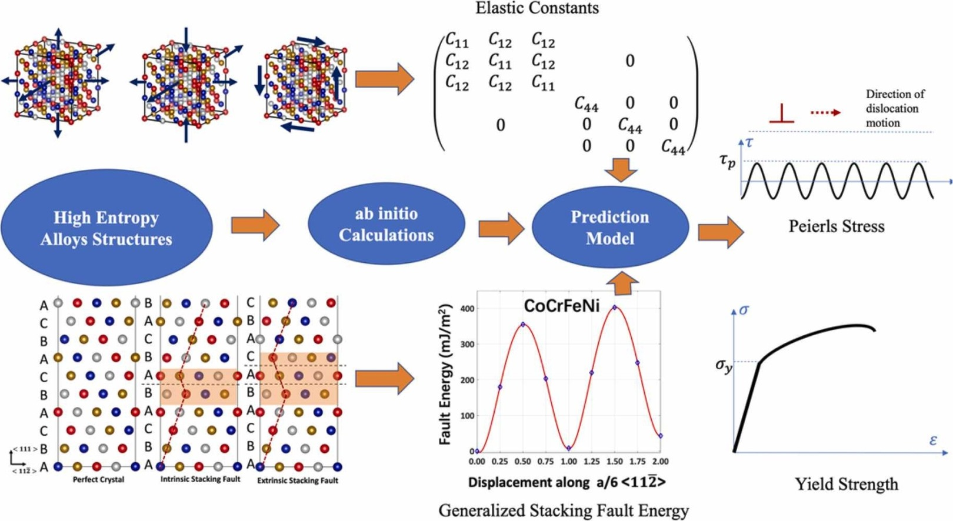
Property Prediction of HEAs using ML
Project Proposal for Course ME793 - 2024
Stage 1
Team ID: 36
Shiv Modi [19D100011]
Nemakallu Mokshit Naidu [200100104]
Archit Mundada [22B2259]

Slide 2
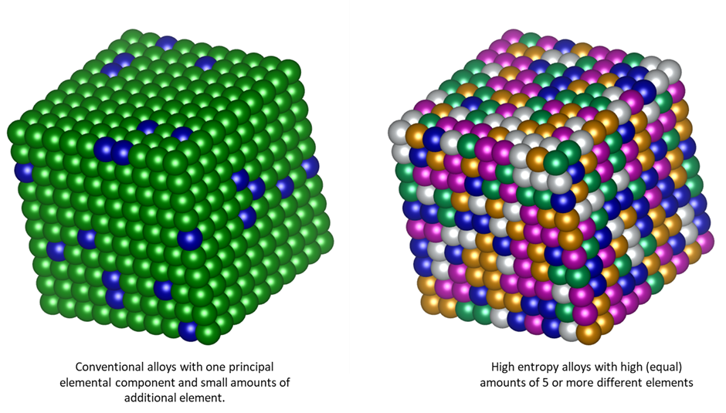
Background of the Problem
Where did you find it ?​
While researching on what topic to choose, we went through the topics shared in class and the group sat together to do some preliminary research. We primarily scoured online sites for something that interests all three of us and finally found this paper on Science Direct - Yield strength prediction of high-entropy alloys using machine learning.
Why is it important ?​
Predicting the properties of HEAs is important for several reasons:
Material Design and Optimization
Performance Assessment
Cost Reduction
HEAs tend to have ‘good’ properties
Understanding Structure-Property Relationships
Overall, accurate prediction of properties of high-entropy alloys is essential for advancing the development and application of promising materials in various industries.

Slide 3
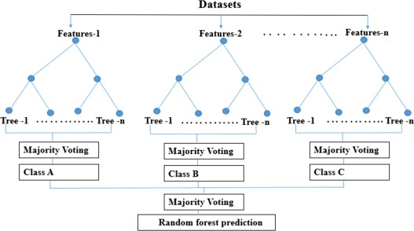
How is it solved currently / traditionally ?​
Traditionally, predicting the yield strength of HEAs involves a combination of Experimental Characterization, Empirical Models, Phase Diagram Analysis, First Principles Calculations and Atomistic Solutions.
The authors in this paper try to predict the yield strength of HEAs at a desired temperature, and it is solved using a Random Forest (RF) regressor model, while we will implement other machine learning algorithms and compare model accuracy with the above, apart from fine-tuning the existing model parameters.
What are the shortcomings in the current solution ?​
While traditional methods for predicting the yield strength of high-entropy alloys (HEAs) have been valuable, they come with several limitations such as Limited Predictive Accuracy, High Computational Cost, Empirical Assumptions, and Limited Insight into Complex Relationships; Machine Learning provides with Data-Driven Predictions, Nonlinear Modeling, Scalability and Efficiency, and Feature Extraction.
In general, RF algorithms are fast to train, but the limitations of random forest is that a large number of trees can make the algorithm slow and ineffective for real-time analytics / predictions once trained, and also can’t describe relationships within datasets.
Have you been able to find Data?
Yes, we have - Source 1, Source 2

Slide 4
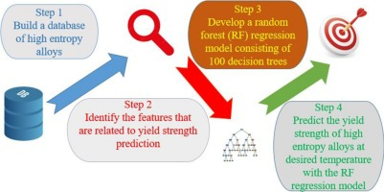
Motivation & Objectives
Motivation:
HEAs have many ‘good’ properties
Traditional trial and error method is costly and time consuming
Thus, a good ML model can help us in this pursuit
Particularly, finding the relationship between alloy properties is of great scientific importance
Further, a model that can predict alloy composition for a given set of requirements is highly desirable
There are vast datasets available for HEAs
Objectives:
Utilizing a Random Forest (RF) regressor model to predict yield strengths of MoNbTaTiW and HfMoNbTaTiZr at 800°C, 1200°C, and 1500°C. [1]
Incorporating features like mixing of entropy, bulk modulus, valence electron concentration, and melting temperature in the ML model.
Testing other algorithms like SVM[2], GP[3], KNN[4], NN[5] to predict other properties like UTS, phase type, Melting point, etc.
If time avails, creating a model that predicts possible HEA compositions for a user defined property

Slide 5
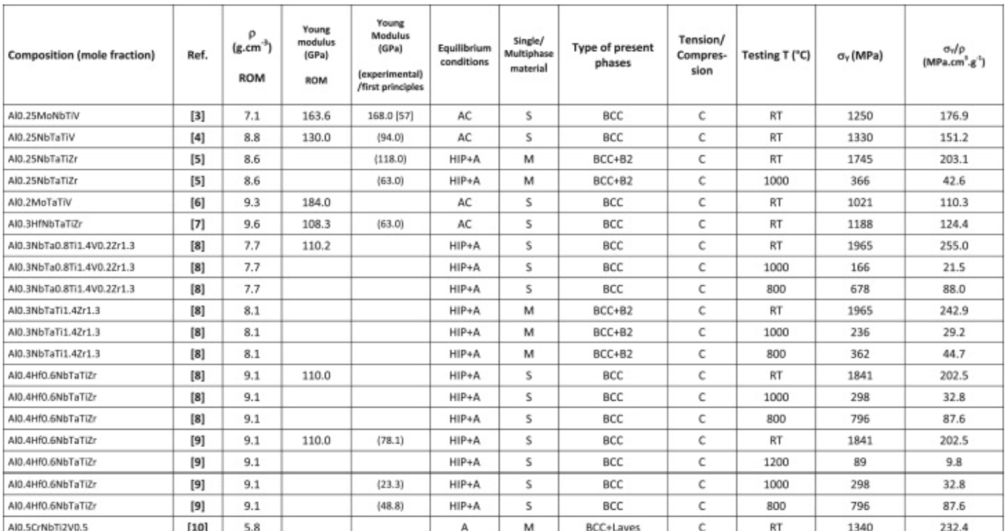
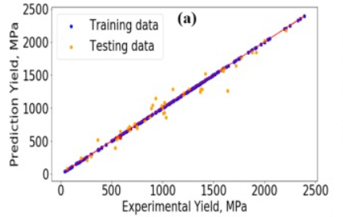
Methodology
Data collection from various papers
Replicating the RF model to predict YS
Testing other algorithms like SVM, GP, KNN, NN
[2], [3], [4], [5]
Understanding the reasons for performance differences
Sources of data: [6], [7], [8] (more sources are available)
Validation method: we will make validation set using train-test split to validate during training of model
Attempting to create a model that does the inverse

Slide 6
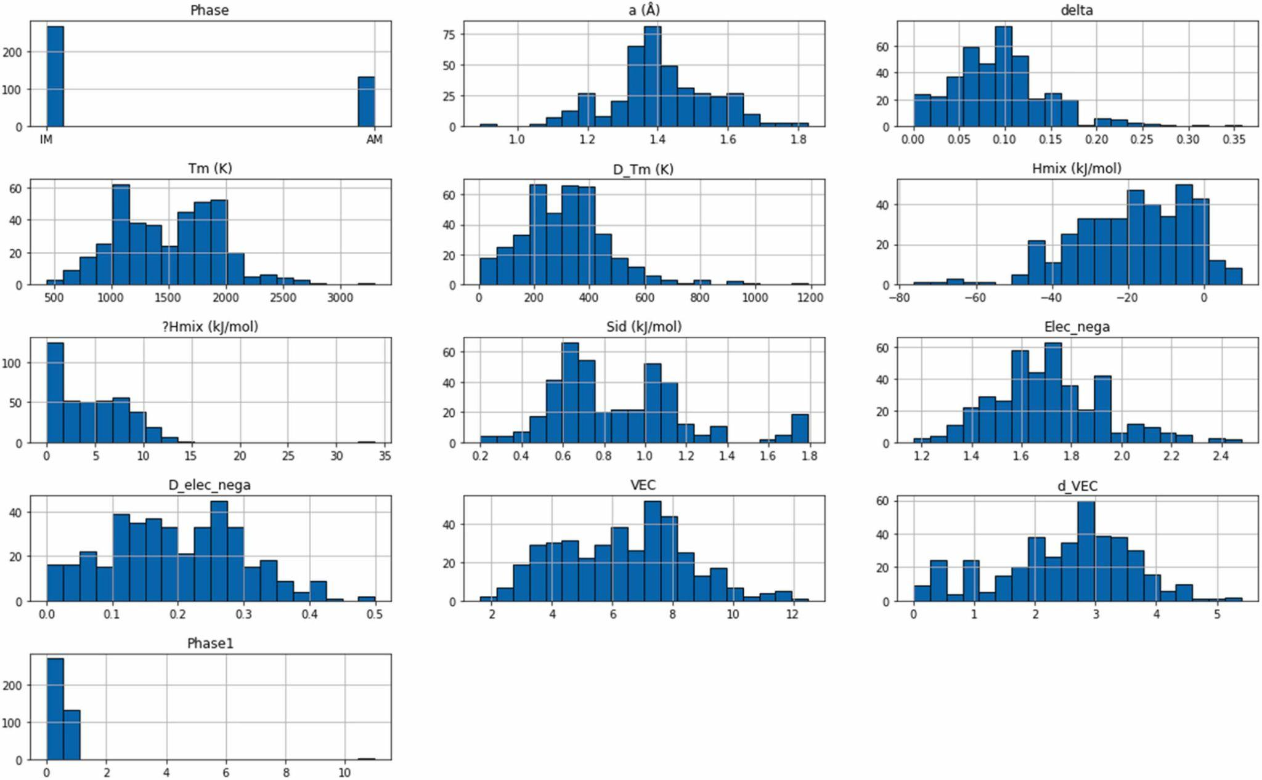
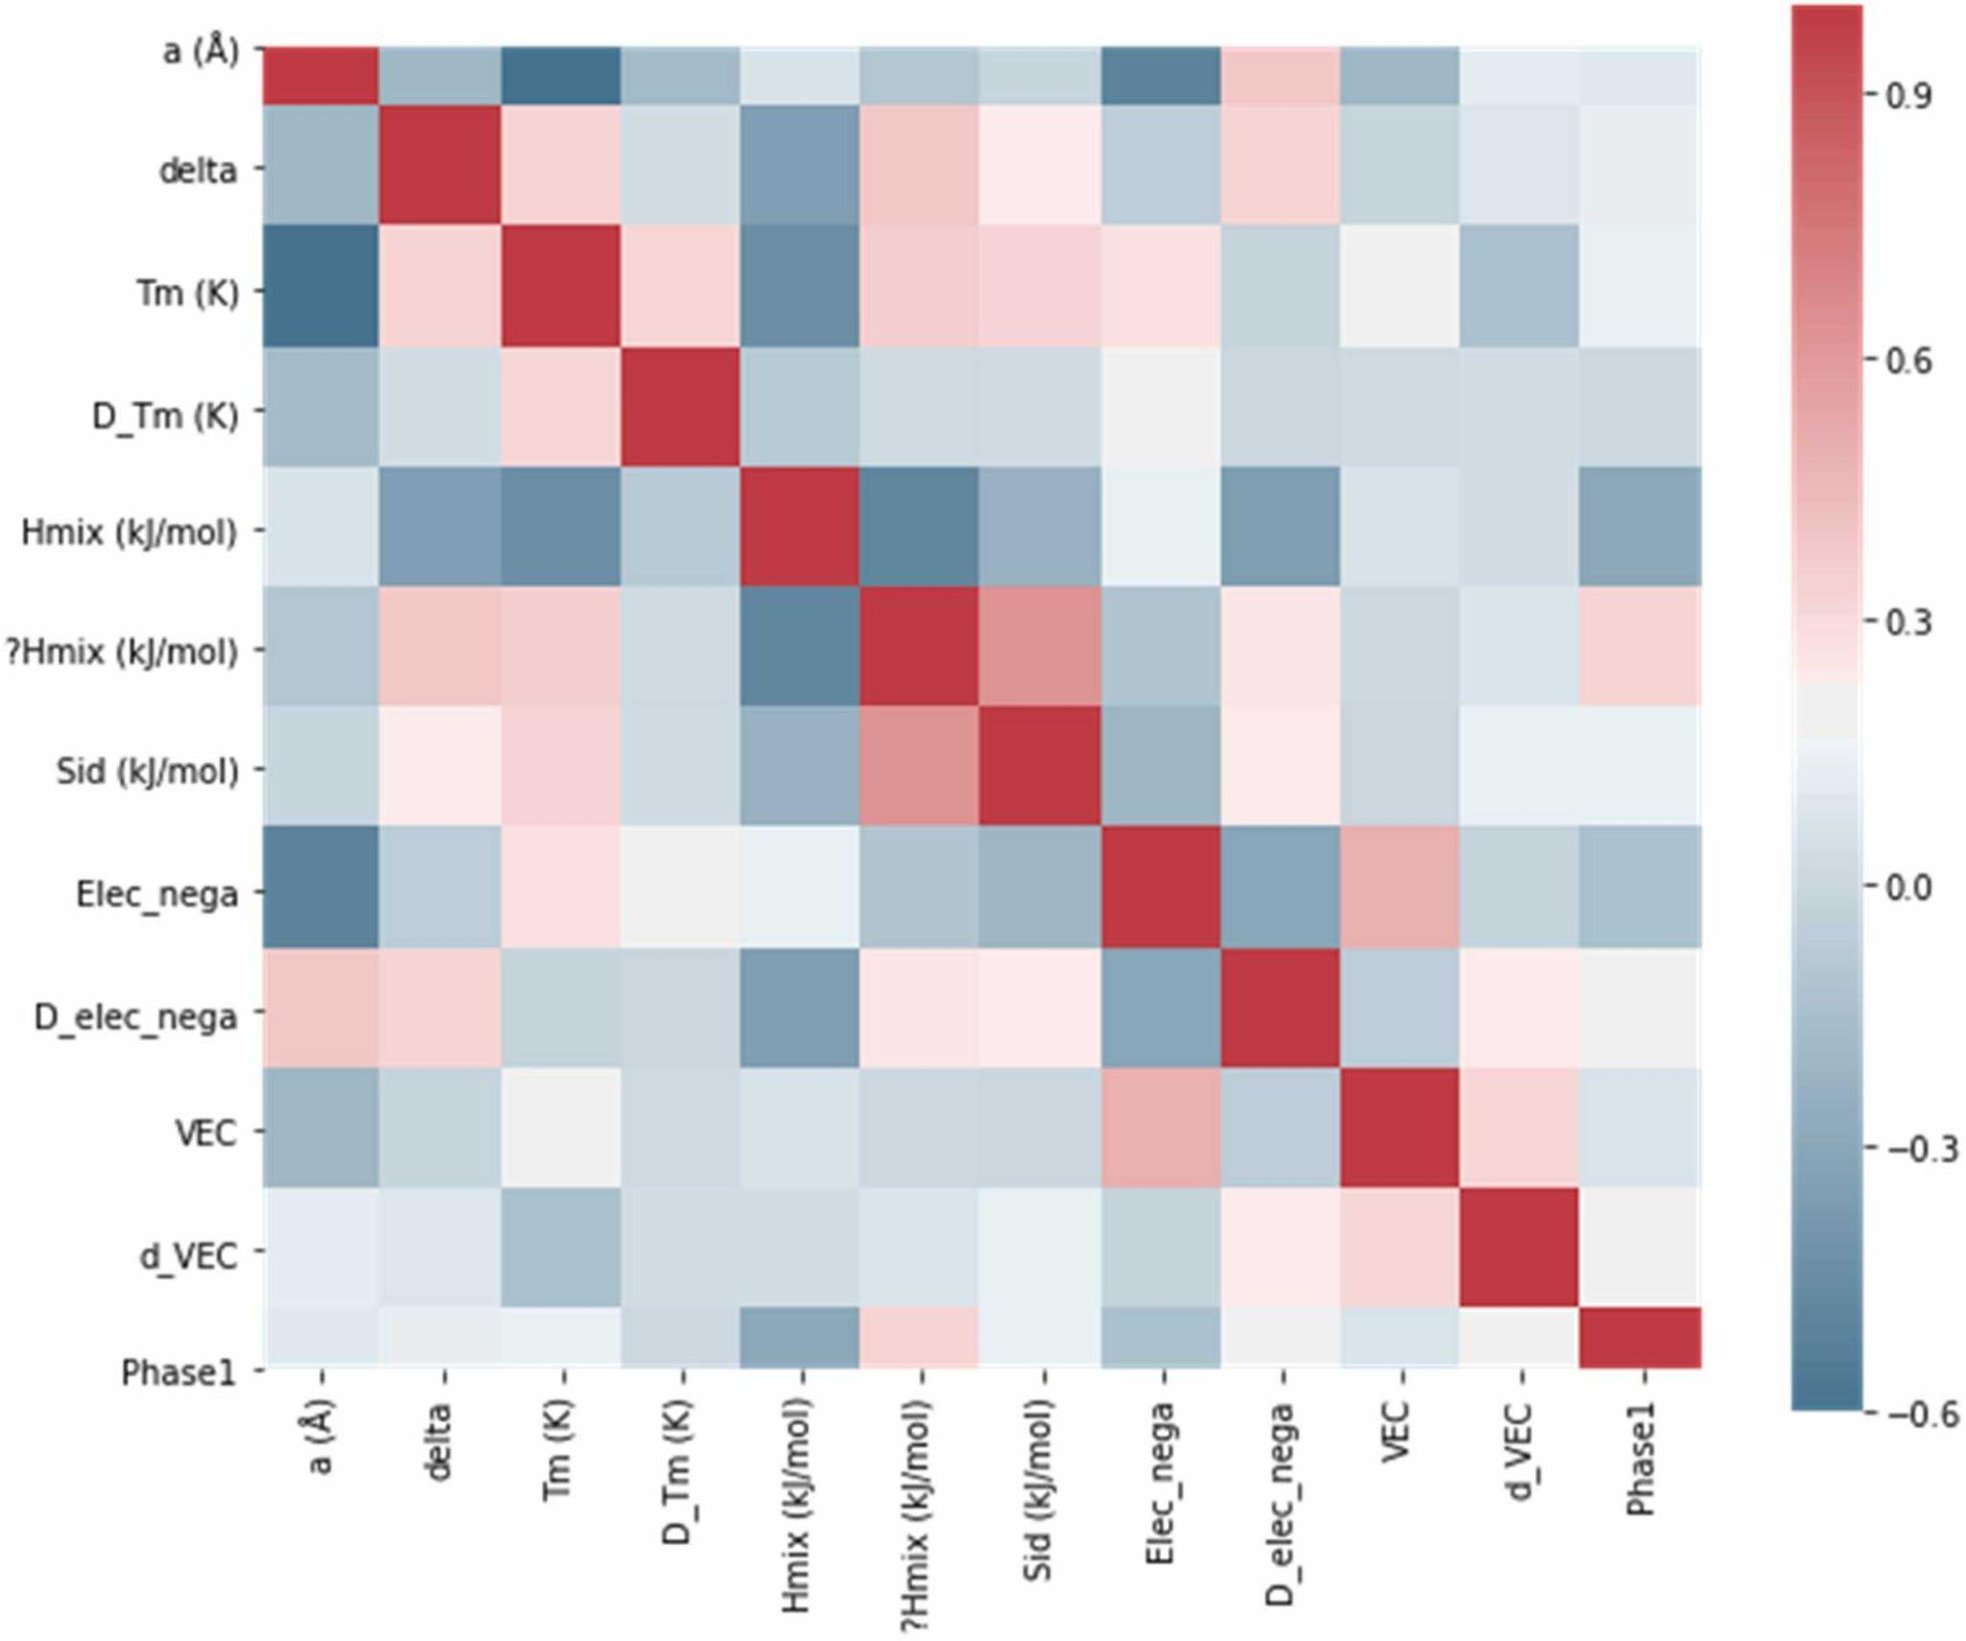
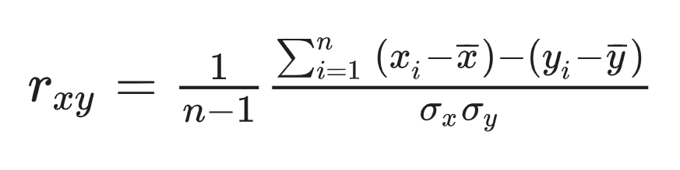
Initial data processing
To find the correlation between the features, we performed statistical analysis by calculating the Pearson correlation coefficient using the Pandas library. This uses the formula:
We also plotted the numerical spread of the data using histograms, where X axis represents the bin range and Y axis represents frequency.

Slide 7
Challenges
Data Quality and Availability: The data available might be scattered across various sources and may not always be consistent or well-documented.
Feature Selection and Engineering: Identifying relevant features or descriptors that adequately represent the composition, microstructure, and processing parameters of HEAs is crucial for building accurate ML models. Feature engineering may require experimentation to determine which features are most informative for predicting the properties of interest.
Model Validation and Uncertainty Quantification: Validating ML models for property prediction requires rigorous testing against independent datasets or experimental measurements.
Model Complexity and Interpretability: ML models vary in complexity, ranging from simple linear regression to complex deep learning architectures. Balancing model complexity is essential for a good model.
Exit Plan: We will show the evaluation matrix of our model and explain the reason for failure while applying it.

Slide 8
Thank you!
Have a nice day!

